Slide 1
BITS Pilani presentation
K. Venkata Ratnam
Mathematics

Slide 2
Course Number : SS ZC416
Course Title: MATHEMATICAL FOUNDATIONS
FOR DATA SCIENCE
Lecture No. :14

Slide 3
NOTICE
CL ON 21-NOV-2020

Slide 4
Problem
Draw an undirected graph represented by the given adjacency matrix.

Slide 5
Problem
Construct the underlying undirected graph for the graph
with directed edges in

Slide 6
Definitions
Determine the number of vertices and edges and find the in-degree and out-degree of each vertex for the given directed multigraph.
Determine the sum of the in-degrees of the vertices and the sum of the out-degrees of the vertices directly. Show that they are both equal to the number of edges in the graph.
Edges = 13, sum of deg in = 6 + 1 + 2 + 4 + 0 = 13
sum of deg out = 1 + 5 + 5 + 2 + 0= 13

Slide 7
Problem
Draw these graphs.
a) K₇ b) K_{1,8} c) K_{4,4} d) C₇
e) W₇
How many vertices and how many edges do these graphs have?
a) K_{n} b) C_{n} c) W_{n} d) K_{m,n}

Slide 8
Problem
For which values of n are these graphs bipartite?
a) K_{n} b) C_{n} c) W_{n}
K₁ is bipartite if we allow one of the sets to be empty.
K₂ is bipartite because we can let one vertex be in V1 and the other vertex to be in V2.
K_{n} for n ≥ 3 is not bipartite: choose any 3 vertices. They all are pairwise connected, therefore there is no way to partition them into two disjoint sets V1 or V2 such that there are no edges within V1 and no edges within V2.

Slide 9
Solution
C_{n} is bipartite if and only if n is even.
Label the vertices by 1, 2, ... consecutively along the cycle. If vertex 1 is in V1 then vertex 2 must be in V2, vertex 3 must be in V1, vertex 4 must be in V2, and so on. All vertices with odd number are in V1 and all vertices with even number are in V2. The last vertex is in V1 if n is odd and it is in V2 if n is even. But it is connected to vertex 1. We see that if n is odd, the graph is not bipartite, and if n is even, the graph is bipartite.
Wn is not bipartite for any value of n, since the center vertex is adjacent to every other vertex in the graph. This is shown in the example to the left with W6.

Slide 10
Definitions
A path is a sequence of edges that begins at a vertex of a graph and travels from vertex to vertex along edges of the graph.
Let n be a nonnegative integer and G an undirected graph. A path of length n from u to v in G is a sequence of n edges e1, . . . , en of G for which there exists a sequence x0 = u, x1, . . . , xn−1, xn = v of vertices such that ei has, for i = 1, . . . , n, the endpoints xi−1 and xi .
When the graph is simple, we denote this path by its vertex sequence x0, x1, . . . , xn (because listing these vertices uniquely determines the path).

Slide 11
Defintion
The path is a circuit if it begins and ends at the same vertex, that is, if u = v, and has length greater than zero.
The path or circuit is said to pass through the vertices x1, x2, . . . , xn−1 or traverse the edges e1, e2, . . . , en.
A path or circuit is simple if it does not contain the same edge more than once.

Slide 12
Definition
The term walk is used instead of path, where a walk is defined to be an alternating sequence of vertices and edges of a graph, v0, e1, v1, e2, . . . , vn−1, en, vn, where vi−1 and vi are the endpoints of ei for i = 1, 2, . . . , n.
Closed walk is used instead of circuit to indicate a walk that
begins and ends at the same vertex, and trail is used to denote a walk that has no repeated edge (replacing the term simple path).
The terminology path is often used for a trail with no repeated vertices, conflicting with the terminology.

Slide 13
Definitions
Let n be a nonnegative integer and G a directed graph. A path of length n from u to v in G is a sequence of edges e1, e2, . . . , en of G such that e1 is associated with (x0, x1), e2 is associated with (x1, x2), and so on, with en associated with (xn−1, xn), where x0 = u and xn = v.
When there are no multiple edges in the directed graph, this path is denoted by its vertex sequence x0, x1, x2, . . . , xn.
A path of length greater than zero that begins and ends at the same vertex is called a circuit or cycle.
A path or circuit is called simple if it does not contain the same edge more than once.

Slide 14
Isomorphism of graphs
Connectedness
Components
Euler, Hamilton paths and cycles

Slide 15
Isomorphism.
The simple graphs G1 = (V₁,E₁) and G₂ = (V₂,E₂) are isomorphic if there exists a one to-one and onto function f from V₁ to V₂ with the property that a and b are adjacent in G1 if and only if f (a) and f (b) are adjacent inG2, for all a and b in V1. Such a function f is called an isomorphism.
∗ Two simple graphs that are not isomorphic are called non-isomorphic.
Two simple graphs are isomorphic, there is a one-to-one correspondence between vertices of the two graphs that preserves the adjacency relationship.
Isomorphism of simple graphs is an equivalence relation.

Slide 16
Definitions
There are n! possible one-to-one correspondences between the vertex sets of two simple graphs with n vertices. { if n is large it is impractical}
Sometimes it is not hard to show that two graphs are not isomorphic.
In particular, we can show that two graphs are not isomorphic if we can find a property only one of the two graphs has, but that is preserved by isomorphism.
A property preserved by isomorphism of graphs is called a graph invariant.

Slide 17
Definitions
Isomorphic simple graphs must have the same number of vertices.
Isomorphic simple graphs also must have the same number of edges.
The degrees of the vertices in isomorphic simple graphs must be the same.
In summary:
The number of vertices, the number of edges, and the number of vertices of each degree are all invariants under isomorphism. If any of these quantities differ in two simple graphs, these graphs cannot be isomorphic.

Slide 18
Isomorphism
To show that a function f from the vertex set of a graph G to the vertex set of a graph H is an isomorphism, we need to show that f preserves the presence and absence of edges.
One helpful way to do this is to use adjacency matrices.
In particular, to show that f is an isomorphism, we can show that the adjacency matrix of G is the same as the adjacency matrix of H, when rows and columns are labelled to correspond to the images under f of the vertices in G that are the labels of these rows and columns in the adjacency matrix of G.

Slide 19
Problem
Determine whether the given pair of graphs is isomorphic. Exhibit an isomorphism or provide a rigorous argument that none exists.
The graphs are isomorphic. One isomorphism is the following: f(v1) = u2, f(v2) = u3, f(v3) = u4, f(v4) = u5, f(v5) = v1.
This graph is isomorphic. One isomorphism is f(u1) = v5, f(u2) = v2, f(u3) = v3, f(u4) = v6, f(u5) = v4, and f(u6) = v1.

Slide 20
Problem
Number of Vertices u = 5, v = 5
Number of edges u = 7, v = 7
Set of degrees u{3, 2, 3, 3, 3}, v{2, 4, 3, 2, 3}
Since there are vertices that can't map to the other set because there are not an equal number of vertices with the same degree, then this pair can not be an isomorphism

Slide 21
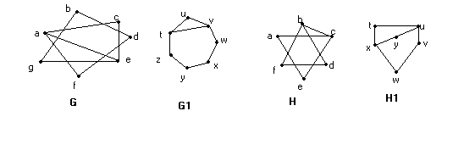
Note
There are several ways that paths and circuits can help determine whether two graphs are isomorphic.
For example, the existence of a simple circuit of a particular length is a useful invariant that can be used to show that two graphs are not isomorphic.
In addition, paths can be used to construct mappings that may be isomorphisms

Slide 22
Problem
Does each of these lists of vertices form a path in the following graph? Which paths are simple? Which are circuits? What are the lengths of those that are paths?
a) a, e, b, c, b
b) a, e, a, d, b, c, a
c) e, b, a, d, b, e
d) c, b, d, a, e, c

Slide 23
Sol.
This is a path of length 4, but it is not simple, since edge {b, c} is used twice. It is not a circuit, since it ends at a different vertex from the one at which it began.
b) This is not a path, since there is no edge from c to a.
c) This is not a path, since there is no edge from b to a.
d) This is a path of length 5 (it has 5 edges in it). It is simple, since no edge is repeated. It is a circuit since it ends at the same vertex at which it began.

Slide 24
Definitions
Let G be a graph with adjacency matrix A with respect to the ordering v1, v2, . . . , vn of the vertices of the graph (with directed or undirected edges, with multiple edges and loops allowed).
The number of different paths of length r from v_{i} to v_{j} , where r is a positive integer, equals the (i, j )th entry of A^{r} .
A^{r+1} = A^{r} . A

Slide 25
Connected graph
An undirected graph is called connected if there is a path between every pair of distinct vertices of the graph.
An undirected graph that is not connected is called disconnected.
We say that we disconnect a graph when we remove vertices or edges, or both, to produce a disconnected subgraph.
There is a simple path between every pair of distinct vertices of a connected undirected graph.

Slide 26
Strongly weekly connected graphs
A directed graph is strongly connected if there is a path from a to b and from b to a whenever a and b are vertices in the graph.
A directed graph is weakly connected if there is a path between every two vertices in the underlying undirected graph.

Slide 27
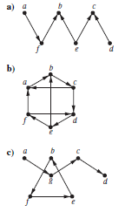
Problem
Determine whether each of these graphs is strongly connected and if not, whether it is weakly connected.
a) not strongly connected, but weakly connected
b) Strongly Connected
c) Not strongly connected or weakly connected

Slide 28
Definitions
The removal from a graph of a vertex and all incident edges produces a subgraph with more connected components. Such vertices are called cut vertices (or articulation points).
The removal of a cut vertex from a connected graph produces a subgraph that is not connected.
Analogously, an edge whose removal produces a graph with more connected components than in the original graph is called a cut edge or bridge.
Note that in a graph representing a computer network, a cut vertex and a cut edge represent an essential router and an essential link that cannot fail for all computers to be able to communicate.

Slide 29
Connected component
A connected component of a graph G is a connected subgraph of G that is not a proper subgraph of another connected subgraph of G.
That is, a connected component of a graph G is a maximal connected subgraph of G.
A graph G that is not connected has two or more connected components that are disjoint and have G as their union

Slide 30
Definitions
An Euler circuit in a graph G is a simple circuit containing every edge of G.
An Euler path in G is a simple path containing every edge of G.
Theorem:
A graph will contain an Euler path if it contains at most two vertices of odd degree.
A graph will contain an Euler circuit if all vertices have even degree.

Slide 31
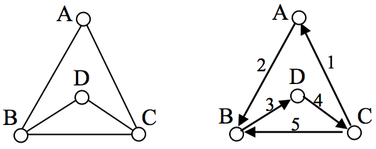
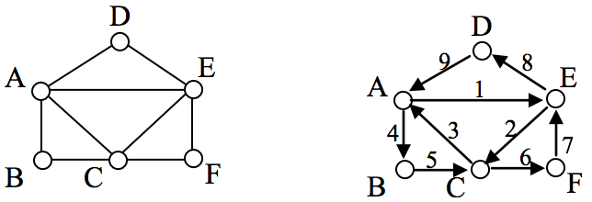
Path and circuit
Every Euler circuit is an Euler path, but not every Euler path is an Euler circuit.

Slide 32
Algorithm

Slide 33
Example
For which values of n do the following graphs have an Euler circuit? Explain why. (a) Kn (b) Cn (c) Wn
A connected multigraph (or graph) has an Euler circuit iff each of its vertices has even degree.
(a) Every vertex has degree n−1, so an odd n results in all degrees being even.
(b) Every vertex in C_{n} has degree 2. C_{n} has an Euler circuit for every n.
(c) Every vertex except the center of W_{n} has degree three. Wn has an Euler circuit for no n.

Slide 34
Definitions
A connected multigraph with at least two vertices has an Euler circuit if and only if each of its vertices has even degree.
A connected multigraph has an Euler path but not an Euler circuit if and only if it has exactly two vertices of odd degree.

Slide 35
Definitions
A simple path in a graph G that passes through every vertex exactly once is called a Hamilton path.
A simple circuit in a graph G that passes through every vertex exactly once is called a Hamilton circuit.
The simple path x0, x1, . . . , xn−1, xn in the graph G = (V ,E) is a Hamilton path if V = {x0, x1, . . . , xn−1, xn} and xi ≠ xj for 0 ≤ i < j ≤ n.
And the simple circuit x0, x1, . . . , xn−1, xn, x0 (with n > 0) is a Hamilton circuit if x0, x1, . . . , xn−1, xn is a Hamilton path.

Slide 36
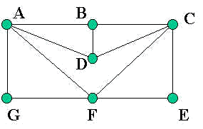
Example
A-G-F-E-C-D-B-A

Slide 37
Theorems
DIRAC’S THEOREM : If G is a simple graph with n vertices with n ≥ 3 such that the degree of every vertex in G is at least n/2, then G has a Hamilton circuit.
ORE’S THEOREM : If G is a simple graph with n vertices with n ≥ 3 such that
deg(u) + deg(v) ≥ n
for every pair of nonadjacent vertices u and v in G, then G has a Hamilton circuit.

Slide 38
Problem
For which values of n do the graphs have a Hamilton circuit
(a) K_{n} (b) C_{n} (c) W_{n}

Slide 39
Example
Can someone cross all the bridges shown in this map exactly once and return to the starting point
The degrees of each node are: 2, 4, 4, and 2. Since every vertex has an even degree you know that there is a Euler circuit (which is what the question is really asking). One possible Euler circuit: A – B – C – B – D – C – A.

